Slide 1
Chapter 16 –
The commmon Controls
Programming Windows with MFC / Jeff Prosise. -- 2nd ed.
Kevin, Guoliang Zhu
CSE791 – Advanced Windows Programming
Summer 2001
Notes:
Hello everybody, in my presentation, I'll introduce the common controls and their MFC interfaces.

Slide 2
Common Controls
an important part of the operating system's look and feel, also your applications
20 types of common controls (Comctl32.dll)
wrapped in classes, easy to use
Dependency on the version of comctl32.dll
Notes:
In chapter 7, several kinds of controls are discussed. They are an essential part of the operating system's look and feel.
, such as pushbutton, Edit control, List Box.
These common controls introduced today are used throughout Windows and are an important part of the operating system's look and feel. In my personal opinion, they may not be necessary for your application sometimes, but it will make your application beautiful and more user-friendly.
These controls are included in the dynamic library comctl32.dll. MFC provides classes to wrap the common controls
Sometimes you may find that your application does not work because you have an older version of this library.

Slide 3
Creating a common control
instantiate the corresponding MFC control class, call the resulting object's Create function
use in dialog box, add a CONTROL statement to a dialog template
#include <afxcmn.h>
CProgressCtrl wndProgress;
wndProgress.Create (WS_CHILD ¦ WS_VISIBLE ¦ WS_BORDER, CRect (x1, y1, x2, y2), this, IDC_PROGRESS);
CONTROL "", IDC_PROGRESS, PROGRESS_CLASS, WS_BORDER, 32, 32, 80, 16
Visual C++ dialog editor writes CONTROL statements for you when you use it to add common controls to a dialog box.
Notes:
There are two ways to create a common control without resorting to API functions. The first is to instantiate the corresponding MFC control class, call It’s Create member function. For example, we want to use a progress control, first we declare an instance of this class, then call the create function with suitable arguments. The second method is to use it in a dialog. We need to add a CONTROL statement to the dialog template. The Visual C++ dialog editor writes CONTROL statements for you when you use it to add common controls to a dialog box. So you don’t need to care so much.It’s easy and convenient. And mostly, many these common controls are used in dialog.

Slide 4
Processing Notification
1) most common controls package their notifications in WM_NOTIFY messages.
2) wParam holds the child window ID of the control
3) lParam holds a pointer to either an NMHDR structure or a structure that's a superset of NMHDR
typedef struct tagNMHDR {
HWND hwndFrom;
UINT idFrom;
UINT code;
} NMHDR
Notes:
Unlike the classic controls, which send notifications to their parents using WM_COMMAND messages, most common controls package their notifications in WM_NOTIFY messages.
hwndFrom holds the control's window handle, idFrom holds the control ID (the same value that's passed in wParam), and code specifies the notification code.

Slide 5
Notifications
NM_CLICK | clicked with the left mouse button
NM_DBLCLK | double-clicked with the left mouse button
NM_RCLICK | clicked with the right mouse button
NM_RDBLCLK | double-clicked with the right mouse button
NM_RETURN | Enter key is pressed while the control has the input focus
NM_KILLFOCUS | The control loses the input focus
NM_SETFOCUS | The control gains the input focus
NM_OUTOFMEMORY | An operation on the control has failed because of insufficient memory

Slide 6
Controls introduced
Slider
Spin
ToolTip
ImageList
ComboBoxEx
Progress control
Animation control
IP Address
Month Calendar control
Date-Time picker control
Notes:
These common controls will be introduced.

Slide 7

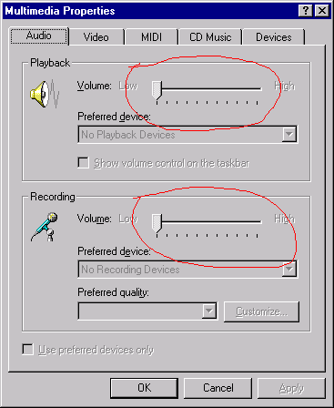
Slider control(1)- Picture
Minimum
Maximum
Posiiton
Click, arrow, drag, or page up & down ,home and end key control
Notes:
Let’s have a look of its picture. You can find many examples in Windows system. This is one in the control panel to set properties of multimedia.
A slider has a thumb that moves like the thumb in a scroll bar. After you create a slider, you set the minimum and maximum values representing the extremes of the thumb's travel and optionally set the initial thumb position. The user can then reposition the thumb by dragging it with the left mouse button or clicking the channel in which the thumb slides. When a slider has the input focus, its thumb can also be moved with the arrow keys, the Page Up and Page Down keys, and the Home and End keys. A simple function call returns an integer representing the thumb position. If desired, you can respond to positional changes as the thumb is moved by processing control notifications.

Slide 8
Slider control (2)---Style
TBS_HORZ | Orients the slider horizontally
TBS_VERT | Orients the slider vertically.
TBS_LEFT | Draw tick marks to the left of a vertical slider
TBS_RIGHT | Draws tick marks to the right of a vertical slider
TBS_TOP | Draws tick marks above a horizontal slider
TBS_BOTTOM | Draws tick marks below a horizontal slider
TBS_BOTH | tick marks both above/left and below/right
TBS_NOTICKS | Removes tick marks from the slider
TBS_AUTOTICKS | Positions a tick mark at each stop in the slider's range
TBS_FIXEDLENGTH | Allows the thumb size to be modified by sending the control a TBM_SETTHUMBLENGTH message.
TBS_NOTHUMB | Removes the thumb from the slider
TBS_ENABLESELRANGE | Widens the slider's channel so that a selection range can be displayed
TBS_TOOLTIPS | Adds a dynamic ToolTip control
Notes:
These are their styles you can set to get your appreciated appearance.

Slide 9
Slider control (3)---Usage
MFC class: CSliderCtrl
CSliderCtrl::SetRange , CSliderCtrl::GetRange
CSliderCtrl::SetPos, CSliderCtrl::GetPos
more than two dozen functions you can use to operate on slider controls
Notes:
How to use it.

Slide 10

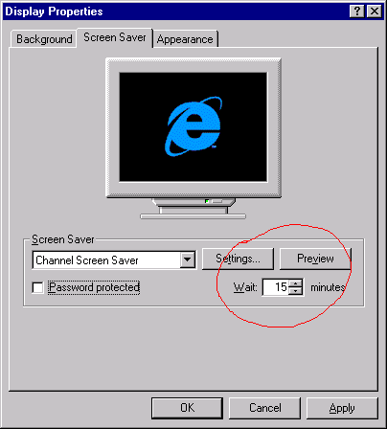
Spin control (1)-Picture
Up-down button
Input
Notes:
Spin button controls, which are also known as up-down controls, are small windows containing arrows that point up and down or left and right. Like scroll bars and sliders, spin buttons maintain their own ranges and positions. Clicking the up or right arrow increments the current position, and clicking the down or left arrow decrements it.

Slide 11
Spin control (2)-Style
UDS_HORZ | Orients the arrows horizontally
UDS_WRAP | Causes the position to wrap around if it's decremented or incremented beyond the minimum or maximum.
UDS_ARROWKEYS | Adds a keyboard interface. (use up and down keys
UDS_NOTHOUSANDS | Removes thousands separators
UDS_SETBUDDYINT | Creates a spin button control that updates the text of a designated buddy control when the position is incremented or decremented.
UDS_AUTOBUDDY | Selects the previous control in the z-order as the spin button's buddy
UDS_ALIGNRIGHT | Attaches the spin button control to the right inside border of its buddy
UDS_ALIGNLEFT | Attaches the spin button control to the left inside border of its buddy

Slide 12
Spin control (3)-Usage
MFC class: CSpinButtonCtrl
CSpinButtonCtrl::SetRange , CSpinButtonCtrl ::GetRange
CSpinButtonCtrl::SetPos, CSpinButtonCtrl ::GetPos
CSpinButtonCtrl::SetBuddy, CSpinButtonCtrl::GetBuddy
CSpinButtonCtrl::SetAccel, CSpinButtonCtrl::GetAccel
CSpinButtonCtrl::SetBase, CSpinButtonCtrl::GetBase
Notes:
Similar to the Spin control, you declare an instance, then use its create method to generate it. You can call its member function such as SetRange to get its maximum and minimum range, use SetPos and GetPos to set and get its value. Or use SetAccel to specify the decreamental and increamental interval.

Slide 13
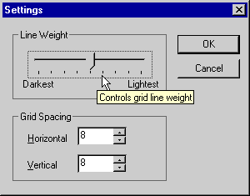
ToolTip control(1)-Picture
MFC: CToolTipCtrl
A ToolTip monitors the movement of mouse, and provides useful information
Notes:
A ToolTip is a miniature help-text window that appears when the cursor pauses over a "tool" such as a button on a toolbar or a control in a dialog box. You simply create a ToolTip control and register the tools for which you'd like ToolTips displayed and the text of the ToolTips.

Slide 14
ToolTip control(2)-Usage
CMyToolTipCtrl m_ctlTT;
m_ctlTT.Create (this);
m_ctlTT.AddTool (pWnd, _T ("This is a window"), NULL, 0);
Many others functions to manipulate this control
Notes:
CToolTipCtrl::AddTool registers a tool and the ToolTip text that goes with it.
Explain more member function

Slide 15
ToolTip control(3)-Style
TTS_ALWAYSTIP | displays ToolTips over both active and inactive windows
TTS_NOPREFIX | not to strip ampersands from ToolTip text

Slide 16
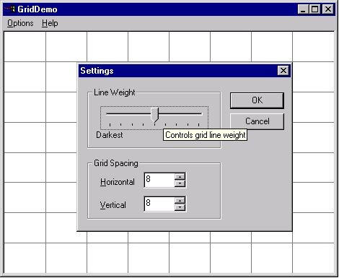
Example 1-GridDemo

Slide 17
Example 1-GridDemo Code (1)
// Dialog Data
//{{AFX_DATA(CSettingsDialog)
enum { IDD = IDD_SETTINGDLG };
CSpinButtonCtrl m_wndSpinVert;
CSpinButtonCtrl m_wndSpinHorz;
CSliderCtrl m_wndSlider;
int m_cx;
int m_cy;
//}}AFX_DATA
// Implementation
protected:
CMyToolTipCtrl m_ctlTT;
};

Slide 18
Example 1-GridDemo Code (2)
BOOL CSettingsDialog::OnInitDialog()
{ CDialog::OnInitDialog();
m_wndSlider.SetRange (0, 8); // Initialize the slider control.
m_wndSlider.SetPos (m_nWeight);
m_wndSpinHorz.SetRange (2, 64); // Initialize the spin button controls.
m_wndSpinVert.SetRange (2, 64);
m_ctlTT.Create (this); // Create and initialize a tooltip control.
m_ctlTT.AddWindowTool (GetDlgItem (IDC_SLIDER), MAKEINTRESOURCE(IDS_SLIDER));
m_ctlTT.AddWindowTool (GetDlgItem (IDC_EDITHORZ),
MAKEINTRESOURCE (IDS_EDITHORZ));
m_ctlTT.AddWindowTool (GetDlgItem (IDC_EDITVERT),
MAKEINTRESOURCE (IDS_EDITVERT));
return TRUE;
}

Slide 19
Example 1-GridDemo Code (3)
in GridDemo.rc
CONTROL "",IDC_SLIDER,"msctls_trackbar32",TBS_AUTOTICKS |
WS_TABSTOP,20,24,100,20
EDITTEXT IDC_EDITHORZ,60,80,40,14,ES_AUTOHSCROLL
CONTROL "Spin1",IDC_SPINHORZ,"msctls_updown32",UDS_SETBUDDYINT |
UDS_ALIGNRIGHT | UDS_AUTOBUDDY | UDS_ARROWKEYS,148,80,28,
12
EDITTEXT IDC_EDITVERT,60,100,40,14,ES_AUTOHSCROLL
CONTROL "Spin1",IDC_SPINVERT,"msctls_updown32",UDS_SETBUDDYINT |
UDS_ALIGNRIGHT | UDS_AUTOBUDDY | UDS_ARROWKEYS,148,100,
11,12
Notes:
Next, demonstrate the application.

Slide 20
Image list control(1)
MFC: CImageList
An important part to GUI of Windows system
Collection of identically sized bitmap image
Provide image to other controls (CListCtrl, CTreeCtrl, etc)
Notes:
An image list is a collection of identically sized bitmap images joined together to form one logical unit.

Slide 21
Image list control(2)-Usage
Ways to create ImageList
  Add image to an empty image list
  Create from an bitmap(with many images)
  Merge existing image lists
Masked Image List
CImageList il;
il.Create (IDB_BITMAP, 18, 1, CLR_NONE);
il.Create (IDB_BITMAP, 18, 1, COLORREF);
Notes:
As other control, the first step to use ImageList is to declare such an instance, then create such an image list. There are three ways to create an Image list.

Slide 22
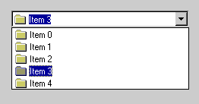
ComboBoxEx Controls(1)
Extended ComboBox, derived from ComboBox
Contain both image and text

Slide 23
ComboBoxEx Controls(2)-Usage
MFC: CComboBoxEx
Extended ComboBox, derived from ComboBox
Main methods:
  InsertItem
  DeleteItem
  GetItem
  SetItem
  Other methods in ComboBox control

Slide 24
ComboBoxEx Controls(3)-Style
CComboBoxEx::SetExtendedStyle
DWORD SetExtendedStyle( DWORD dwExMask, DWORD dwExStyles );
CBES_EX_CASESENSITIVE | Makes string searches case-sensitive
CBES_EX_NOEDITIMAGE | Suppresses item images
CBES_EX_NOEDITIMAGEINDENT | Suppresses item images and left-indents each item to remove the space normally reserved for the item image
CBES_EX_NOSIZELIMIT | Allows the ComboBoxEx control's height to be less than the height of the combo box contained inside the control

Slide 25
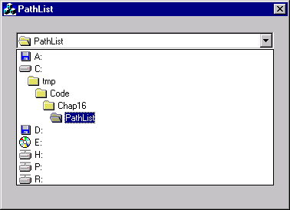
Example 2-PathList

Slide 26
Example 2-PathList code
m_il.Create (IDB_IMAGE, 16, 1, RGB (255, 0, 255));
m_wndCBEx.SetImageList (&m_il);
for (int i=0; i<5; i++)
{
CString string;
string.Format (_T ("Item %d"), i);
COMBOBOXEXITEM cbei;
cbei.mask = CBEIF_IMAGE ¦ CBEIF_SELECTEDIMAGE ¦ CBEIF_TEXT;
cbei.iItem = i; cbei.pszText = (LPTSTR) (LPCTSTR) string;
cbei.iImage = 0; cbei.iSelectedImage = 0;
m_wndCBEx.InsertItem (&cbei);
}

Slide 27
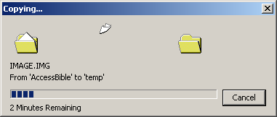
Progress & animation control
Visual feedback
CProgressCtrl, CAnimateCtrl
Used with animation control (often)
Notes:
A progress control is a vertical or horizontal rectangle containing a colored bar that grows as an operation approaches completion

Slide 28
Progress control usage
Style:
Horizontal or vertical
Broken or solid bar
Steps to use it:
Create an instance
Initialize it using SetRange()
Within your operation, set its position SetPos()
When you finish, stop it SetPos(0)

Slide 29
Animation control
Steps to use it:
Create an instance
Initialize it using Open()
Call Play() to play this animation
When you finish, call Stop() to stop
If you don’t want to use, use Close() the file
Notes:
reduces the complex task of playing an AVI file to two simple function calls.
Although animation controls enjoy a variety of uses, very often they are used simply to let the user know that a lengthy operation is underway

Slide 30
Animation control-style
ACS_AUTOPLAY | start playing as soon as it is opened
ACS_TRANSPARENT | draw the AVI clip using a transparent background
ACS_CENTER | Centers the AVI clip in the animation control’s window
ACS_TIMER | sets a timer in the caller's thread and uses timer callbacks to draw successive frames

Slide 31
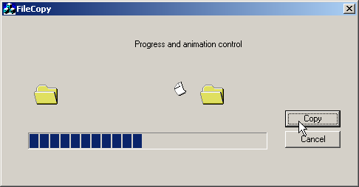
Example 3-FileCopy
  CProgressCtrl m_prog;
  CAnimateCtrl m_animate;
  void CFileCopyDlg::OnButtonCopy()
  {
  m_animate.Play (0, -1, -1);
  for (int i=0; i<100; i++)
  {
  m_prog.SetPos (i);
  ::Sleep (25);
  }
  m_animate.Stop();
  }

Slide 32

IP Address Control
Interface for IP format data 128.230.123.33
Numberic data from 0-255
Set using SetFieldRange()
WinInet

Slide 33
IP Address Control-Notifications
EN_SETFOCUS | the control gained or lost the input focus
EN_KILLFOCUS
EN_CHANGE | the data in the control has changed
IPN_FIELDCHANGED | field's value changes or the input focus moves from one field to another

Slide 34
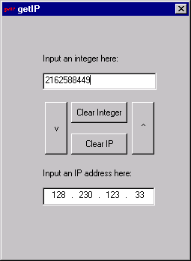
Example 4-getIP
CIPAddressCtrl m_ipaddress;
m_ipaddress.GetAddress( pa, pb, pc, pd );
m_ipaddress.SetAddress(pa,pb,pc,pd);
m_ipaddress.ClearAddress();
m_ipaddress.IsBlank();
.SetFieldFocus(WORD nField);
.SetFieldRange(int nField, BYTE nLower, BYTE nUpper )

Slide 35

HotKey Control
MFC: CHotKeyCtrl
Edit control to convert key combinations
Used to set / display HotKey
SetHotKey()
GetHotKey()
SetRules()
m_hotkey.SetHotKey(_T('P'), HOTKEYF_CONTROL | HOTKEYF_ALT);
Notes:
A hotkey control is essentially a glorified edit control that automatically converts key combinations such as Ctrl-Alt-P into text strings suitable for displaying on the screen

Slide 36
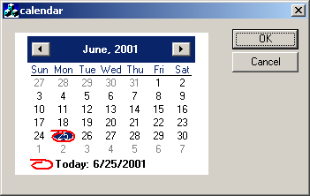
Month Calendar Control
MFC: CMonthCalCtrl
Input data(clicking)
GetCurSel, SetCurSel
GetToday, SetToday
GetRange, SetRange
GetMaxSelCount
SetMaxSelCount
GetSelRange
SetSelRange
Other member function
Notes:
The month calendar control, which I'll refer to simply as the calendar control, lets users input dates by picking them from a calendar rather than typing them into an edit control.
A calendar control can support single selections or multiple selections. Clicking a date in a single-selection calendar control makes that date the "current date."

Slide 37
Calendar-Style and notification
MCS_NOTODAY | removes the line that displays today's date
MCS_NOTODAYCIRCLE | removes the circle that appears around today's date
MCS_WEEKNUMBERS | displays week numbers
MCN_SELECT | the user selects a new date or range of dates
MCN_SELCHANGE | the user explicitly makes a selection, or the selection changes because the user scrolled the calendar backward or forward a month

Slide 38

Date-Time Picker Control
MFC: CDateTimeCtrl
SetTime, GetTime
SetRange, GetRange
GetMonthCalCtrl
GetMonthCalFont, SetMonthCalFont
GetMonthCalColor, SetMonthCalFont
SetFormat
Notes:
A DTP control resembles an edit control, but rather than display ordinary text strings, it displays dates and times.

Slide 39
Date-Time Picker Control - style
DTS_TIMEFORMAT | Display time
DTS_SHORTDATEFORMAT | Display date, short format like 6/27/2001
DTS_LONGDATEFORMAT | Display date, long format like Wednesday, June 27, 2001
DTS_UPDOWN | Use drop-down calendar, or use spin control

Slide 40
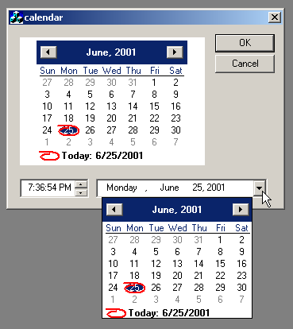
Example 5-Calendar
Notes:
Show the demonstration application.

Slide 41

END
Thank you
for listening

